Slide 1
RESEARCH PROJECT REPORT IN FULFILMENT OF SUMMER INTERNSHIP PROJECT
TOPIC:
FINANCIAL YEAR, ASSESSMENT YEAR,
TAX YEAR, CALENDER YEAR, PREVIOUS YEAR
SUBMITTED BY: SUBMITTED TO:
Saniya Usmani Shashwat Singhal

Slide 2
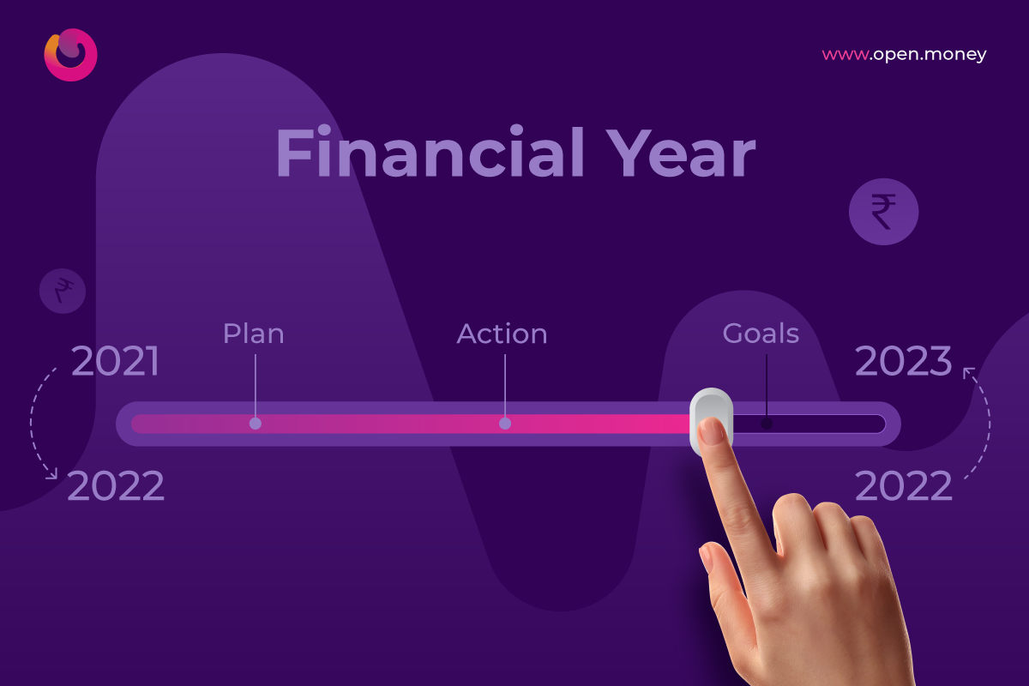
Financial Year (FY)
A Financial Year is the period during which income is earned and financial transactions are recorded.
In India
Starts on 1st April
Ends on 31st March of the next year
Example
FY 2025–26
Begins: 1 April 2025
Ends: 31 March 2026
All income earned during this period is considered for taxation.

Slide 3
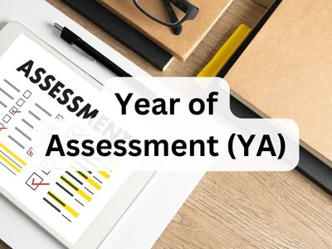
Assessment Year (AY)
Definition
The Assessment Year is the year immediately following the Financial Year in which income is assessed and taxed.
Example
Income earned in FY 2025–26
Assessed in AY 2026–27
Importance
Income Tax Returns (ITR) are filed in the Assessment Year.
Tax authorities assess taxable income during this period.

Slide 4

Previous Year
Under the Income Tax Act, the Previous Year refers to the year in which income is actually earned.
Example
If income is earned during:
1 April 2025 to 31 March 2026
Then:
Previous Year = FY 2025–26
Assessment Year = AY 2026–27
Thus, in most cases, Previous Year and Financial Year are the same.

Slide 5
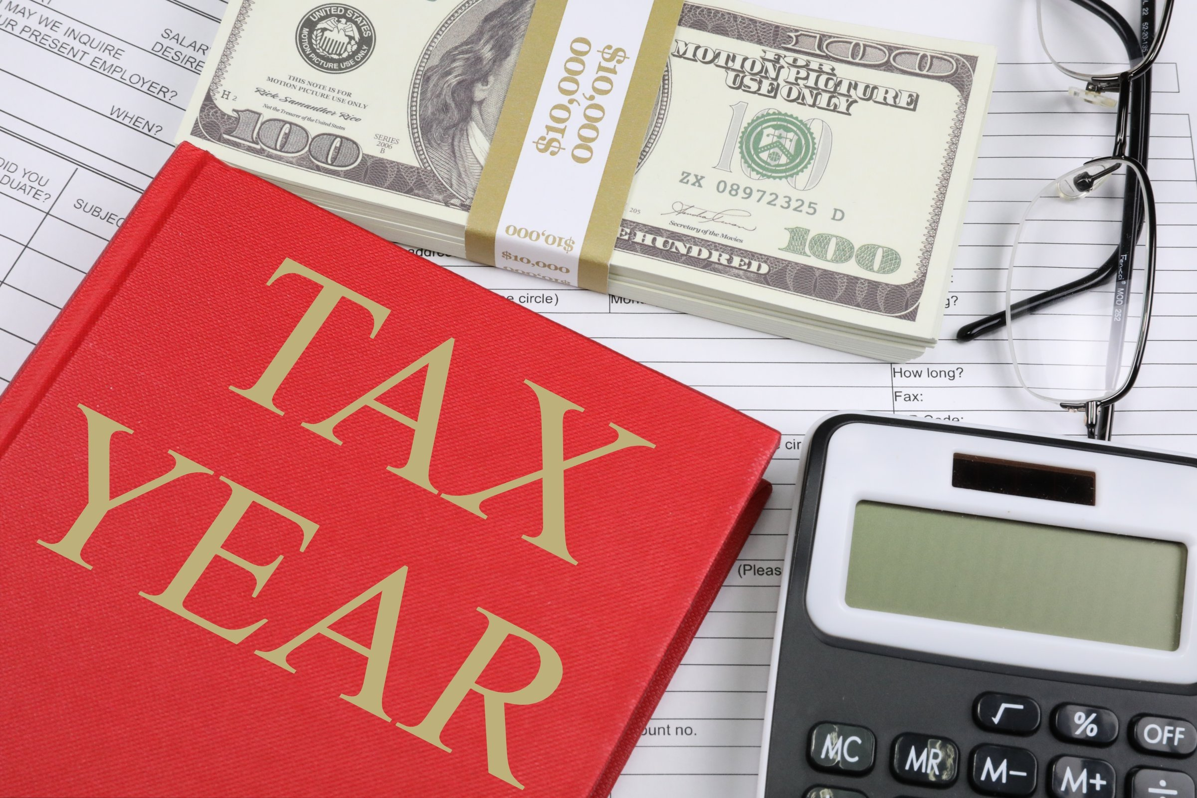
Tax Year
A Tax Year is the period for which tax liability is calculated.
In India
The Tax Year generally coincides with the Financial Year.
Example
Tax Year 2025–26:
1 April 2025 to 31 March 2026
Income earned during this period is used to calculate tax liability.

Slide 6

Calendar Year
A Calendar Year follows the standard January-to-December cycle.
Duration
Starts: 1 January
Ends: 31 December
Example
Calendar Year 2025:
1 January 2025 to 31 December 2025
Many countries and international businesses use the calendar year for reporting purposes.

Slide 7
Comparison table
Term | Period | Purpose
Financial Year | 1 April – 31 March | Recording income and expenses
Assessment Year | Year after FY | Assessment and taxation
Previous Year | Same as FY | Income earning period
Tax Year | Usually same as FY | Tax computation period
Calendar Year | 1 January – 31 December | General civil and business reporting

Slide 8
CONCLUSION
Key Takeaways
Financial Year is the period of earning income.
Assessment Year is when income is assessed for tax.
Previous Year generally equals the Financial Year.
Tax Year is the period used for tax calculations.
Calendar Year runs from January to December.

